Slide 1
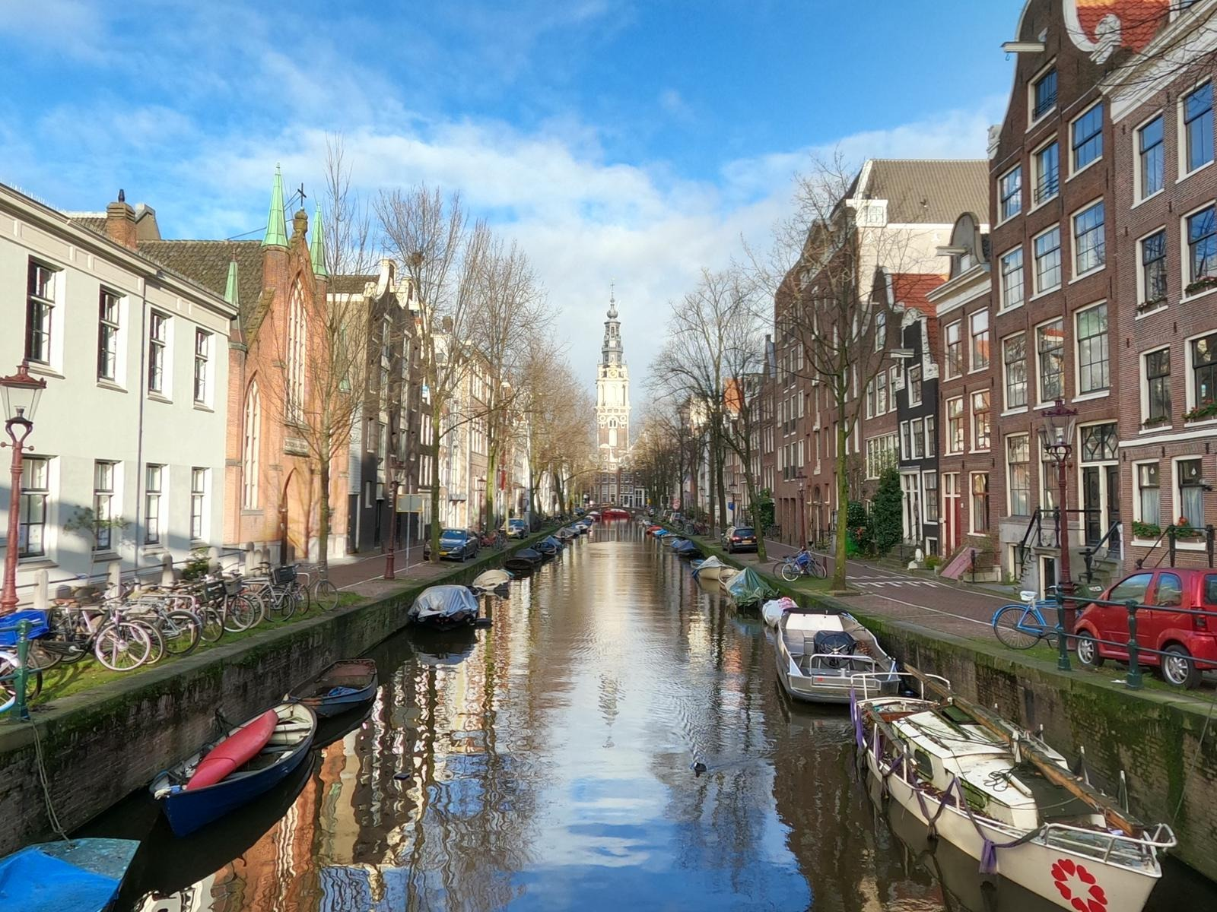

Continuous-wave BECs and superradiant clocks
Continuous-wave BECs and superradiant clocks
Florian Schreck
Florian Schreck
Florian Schreck
University of Amsterdam
University of Amsterdam
University of Amsterdam
Notes:
In short, these are ca. 45 minute colloquia, plus questions, which we stream live on YouTube every Thursday at 17:00 CET (Central European Time), and which take place via Zoom – with committee members introducing the speaker and conveying questions (both after the introduction part of the talk, and at the end). The colloquia are aimed at being accessible to a very broad range of students, postdocs, and researchers, who can then get an introduction to different subfields.

Slide 2

Classical vs. quantum sensors
Task: build the best clock in the world
Pendulum
Atom
Highest accuracy
High transition frequency optical transitions
Narrow transition mHz linewidth
Large signal use many atoms
Undisturbed by other atoms use gas of atoms
No Doppler shift cool atoms to standstill

Slide 3
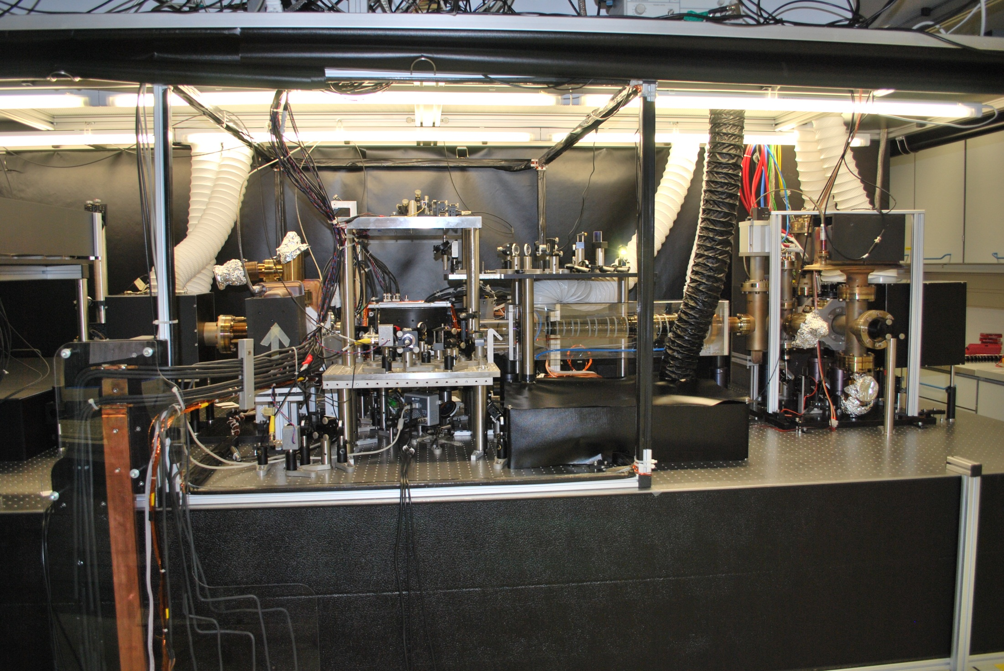
Laser cooling
atomic beam
from oven
slowing laser
Zeeman slower
cooling lasers

Slide 4
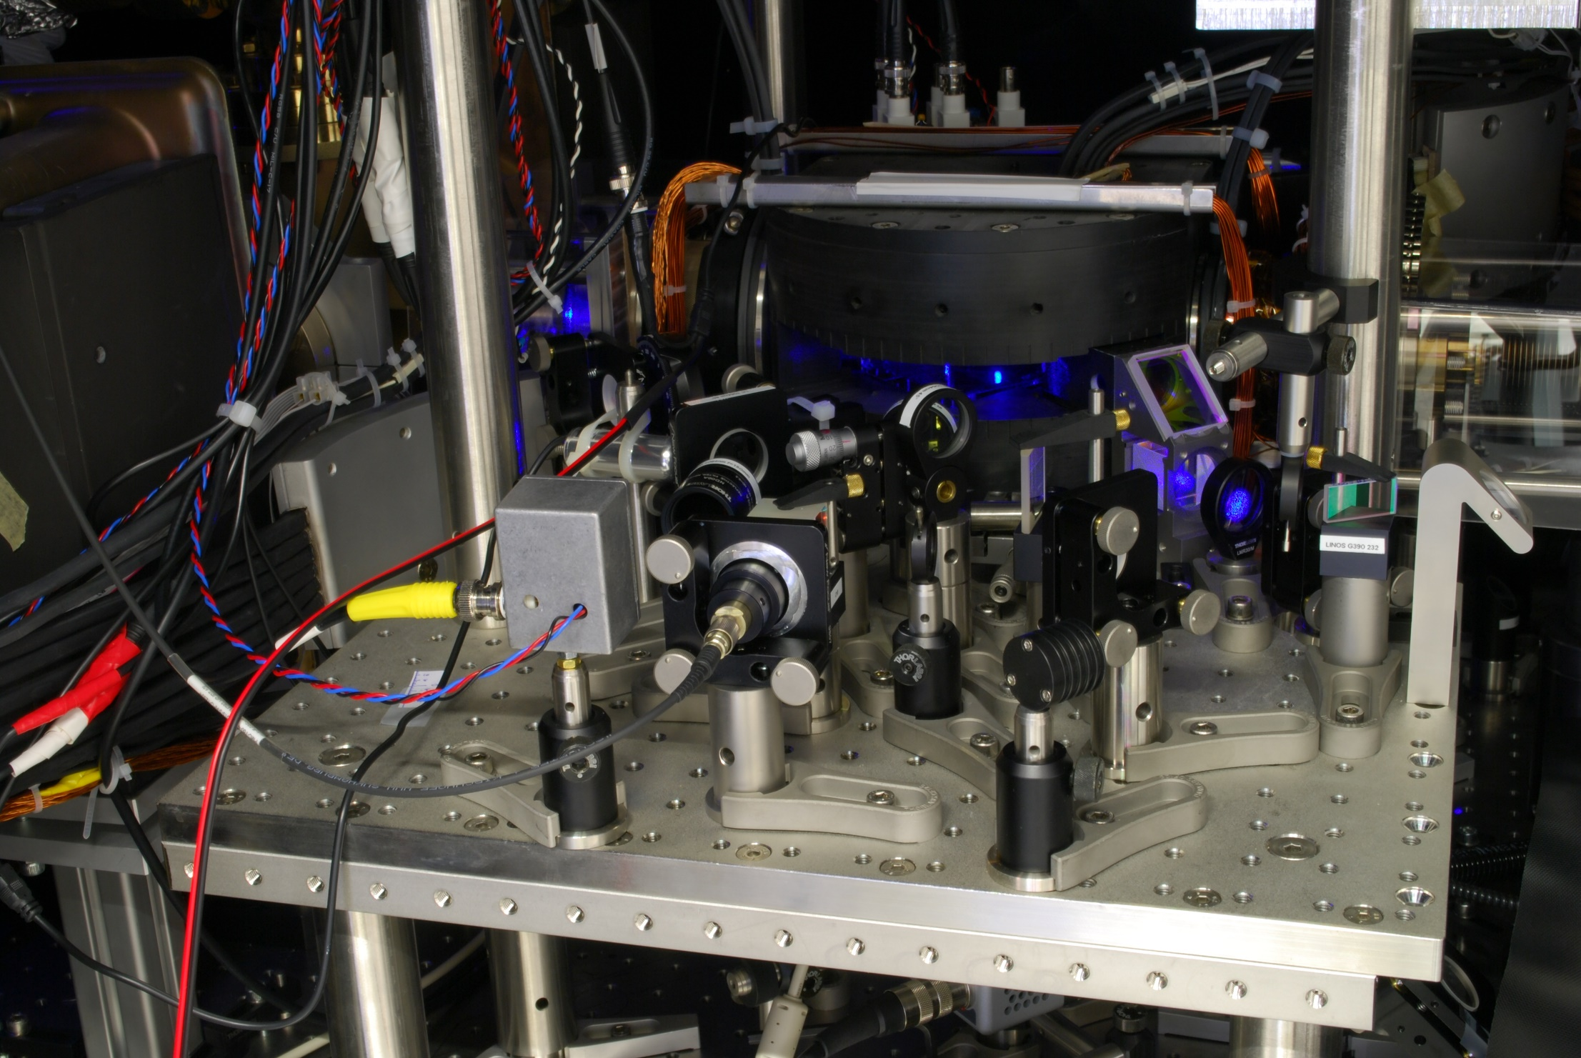
Magneto-optical trap of strontium
MOT

Slide 5
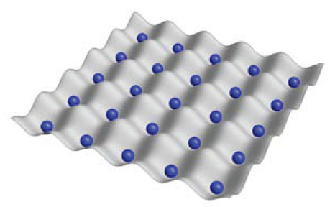

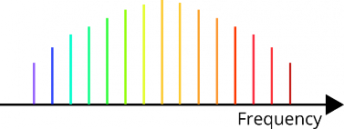
Optical clock scheme
Frequency reference
ultracold Sr atoms in lattice
Clockwork
optical frequency comb
translates optical frequency into microwave frequency
laser

Slide 6

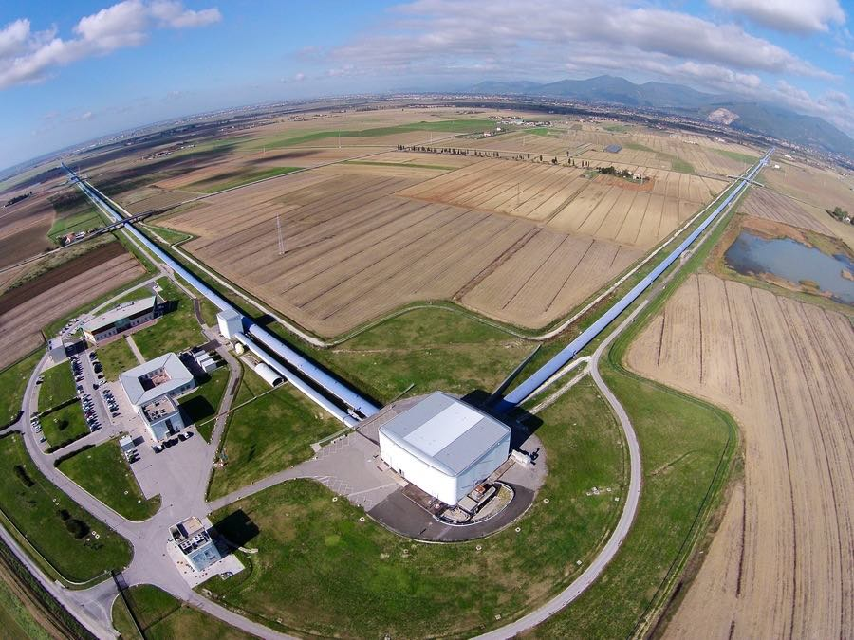
Atom interferometry
Atom interferometer
Laser interferometer
position
atoms
Laser
laser pulses
time
Gravitational wave detection
Detection of
acceleration (gravity, gravity gradient)
rotation
Also profits from ultracold atoms
The Virgo collaboration/CCO 1.0

Slide 7
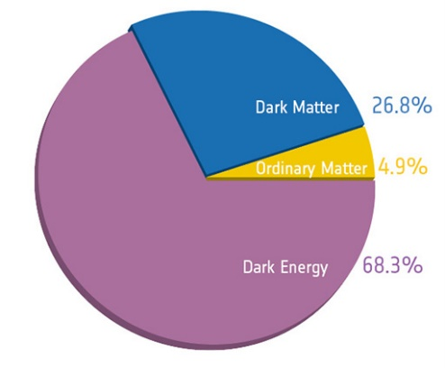
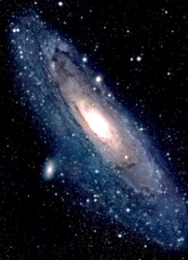

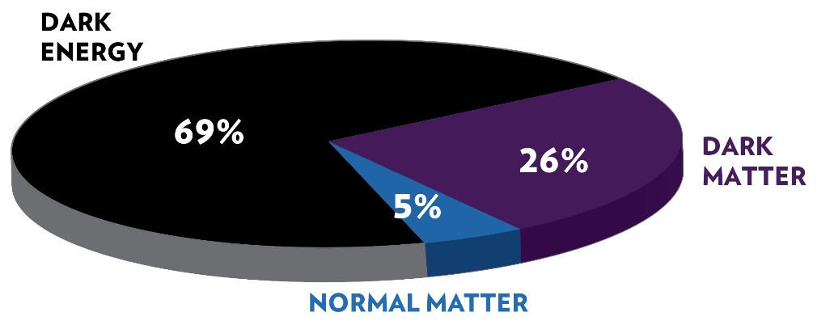

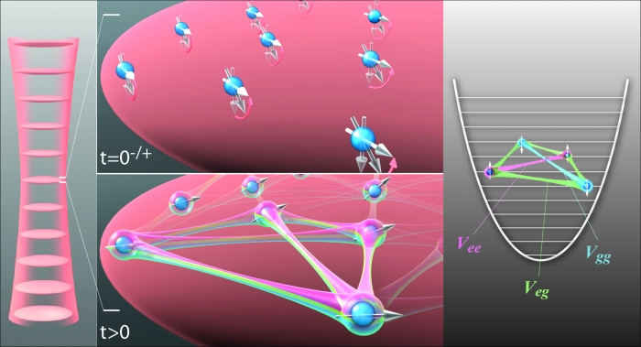
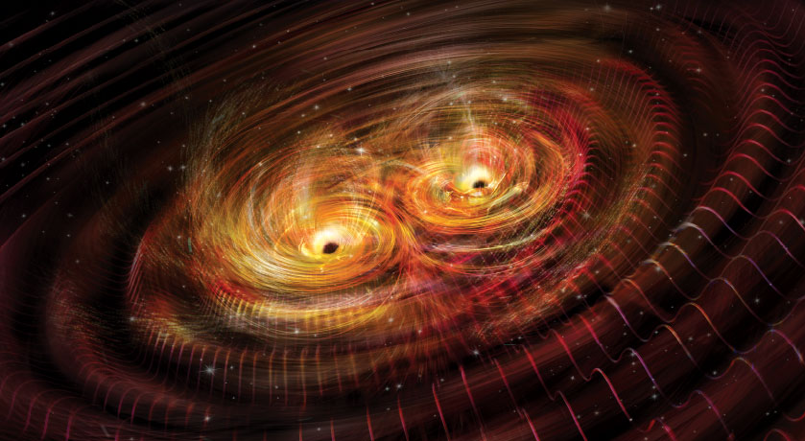
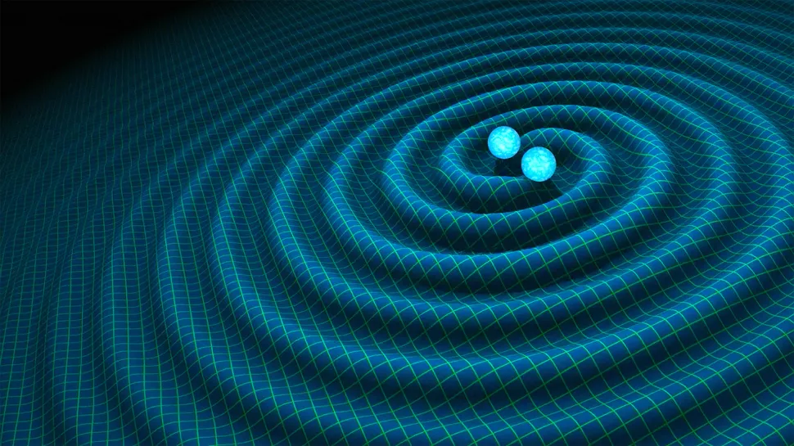

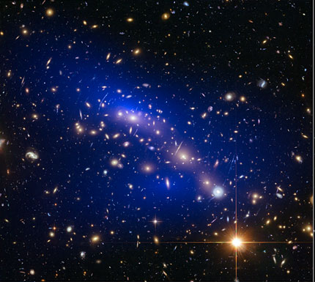
Applications
Fundamental science
Beyond Standard Model physics
Tests of relativity
Do fundamental constants change?
Dark matter searches
QED tests
Explore many-body physics
happening in quantum sensors:
spin models, gauge fields,…
Astronomy
Jun Ye, Ana-Maria Rey groups, JILA
Infrasound gravitational wave detectors
Very-long baseline interferometry
Nicolle Rager Fuller
Society
Network synchronization
Navigation
Underground exploration
NASA
Event Horizon Telescope

Slide 8

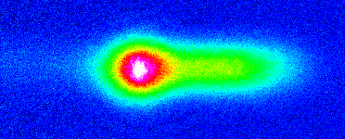
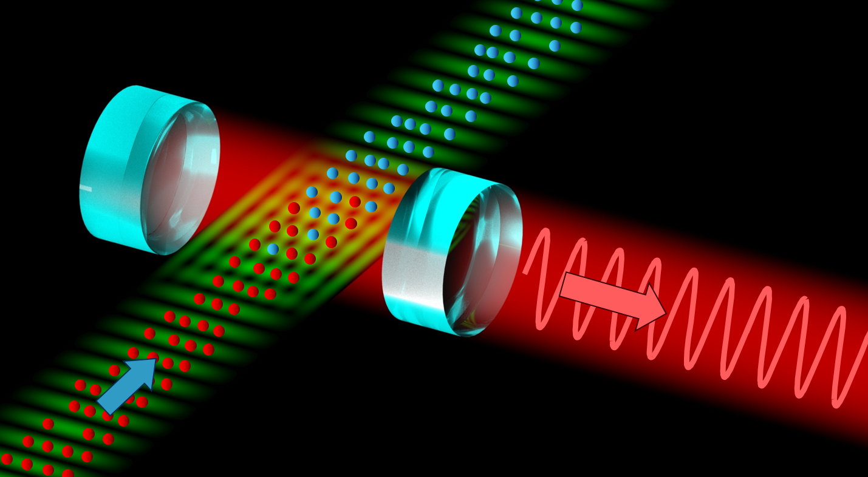
Outline
µK Sr beam in the dark
Continuous-wave BEC
100µm
Superradiant clock
Continuous-wave atom laser
frequency & time
acceleration & rotation

Slide 9
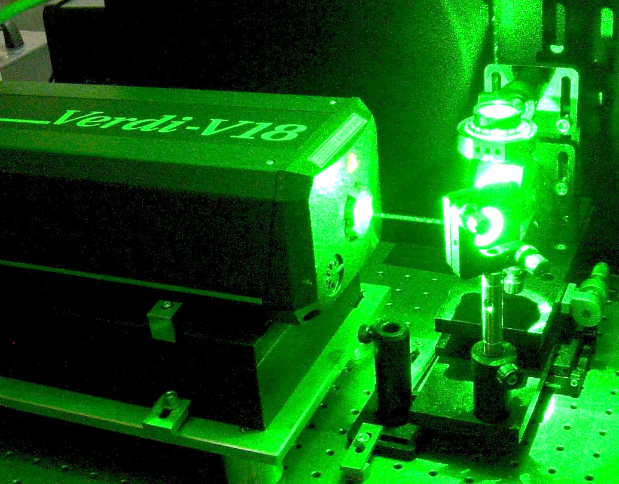
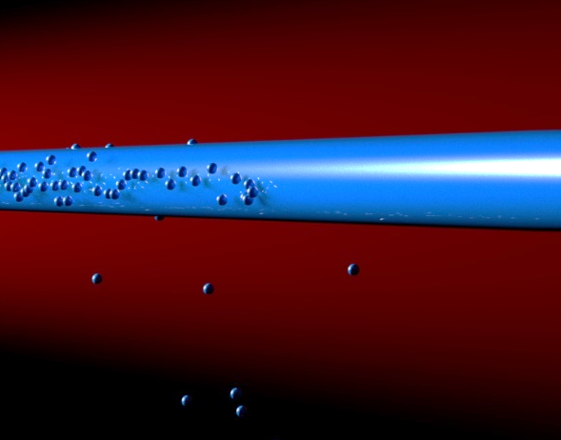
Optical and atom lasers
Laser
Advantages of lasers
Better
Potential for squeezing
brightness
divergence
spatial mode structure
coherence
Light
Matter
Optical laser
Atom laser
Laser interferometer
Atom interferometer
N.P. Robins et al., Atom lasers: Production, properties and prospects for precision inertial measurement, Phys. Rep. 529, 265 (2013)

Slide 10
Creating an atom laser
Optical cavity
Atom cavity (trap)
Pumping
replenish atoms
Pumping
Gain
(e.g. stimulated emission)
Gain
(e.g. Bose-enhanced scattering)
BEC
Outcoupler
Outcoupler
(e.g. transfer to
untrapped state)
N.P. Robins et al., Atom lasers: Production, properties and prospects for precision inertial measurement, Phys. Rep. 529, 265 (2013)

Slide 11
Continuous-wave BEC
Optical cavity
Atom cavity (trap)
Pumping
replenish atoms
Pumping
Gain
(e.g. stimulated emission)
Gain
(e.g. Bose-enhanced scattering)
BEC
Outcoupler
Outcoupler
(e.g. transfer to
untrapped state)
N.P. Robins et al., Atom lasers: Production, properties and prospects for precision inertial measurement, Phys. Rep. 529, 265 (2013)

Slide 12


State-of-the-art: pulsed atom laser
Laser
cooling
Evaporative
cooling
Bose Einstein
condensation
Outcoupling
Depletion
time
Laser emission
Quasi-continuous mode of operation:
BEC creation takes seconds
BEC decays by e.g. molecule formation
atom laser pulse << 1s
Bad for precision measurement:
MIT
1997
Munich
1999
NIST
1999
Loss of phase coherence
Pulsed operation introduces noise (Dick effect)
Low average flux

Slide 13
Our goal: continuous atom laser
Laser
cooling
Evaporative
cooling
Bose Einstein
condensation
Challenges
outcoupling
Poor laser cooling performance of alkalis and chromium
space
BEC incompatible with laser cooling
Steps towards goal
Periodically replenish BEC
Ketterle group, Science 296, 2193 (2002)
Continuous evaporation
Guéry-Odelin group, PR A 72, 033411 (2005)
Raithel group, PR A 73, 033622 (2006)
Pumping mechanism
Close group, nature physics 4, 731 (2008)
Continuous trap loading
Pfau, Griesmaier group, New J. Phys. 15 093012 (2013)
Klempt group, J. Phys. B 48, 165301 (2015)

Slide 14
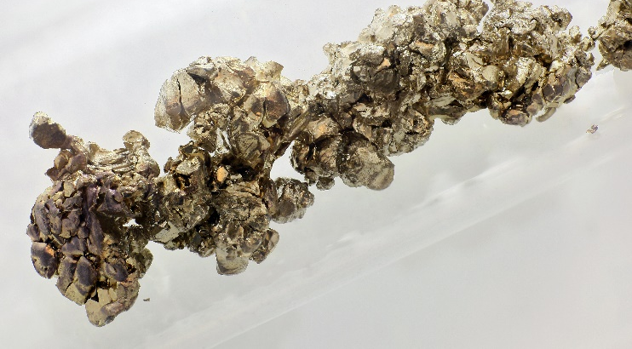
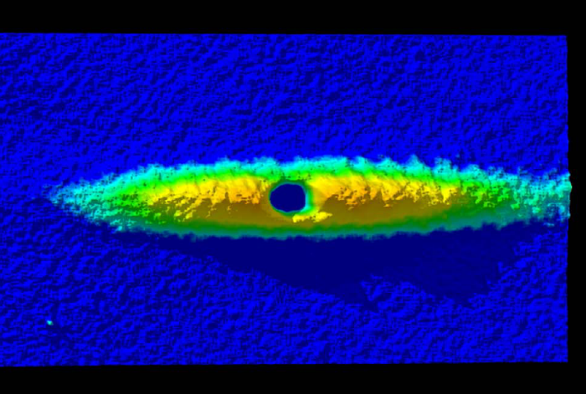
Our tricks
Strontium
Goals of baseline experiment
BEC by removing entropy from gas using only laser cooling
BEC in thermal contact with laser cooled gas
Laser cooling
on narrow transition
Transparency beam
Dimple trick
Increase
phase-space density
Cool to BEC
Protect BEC from photons

Slide 15
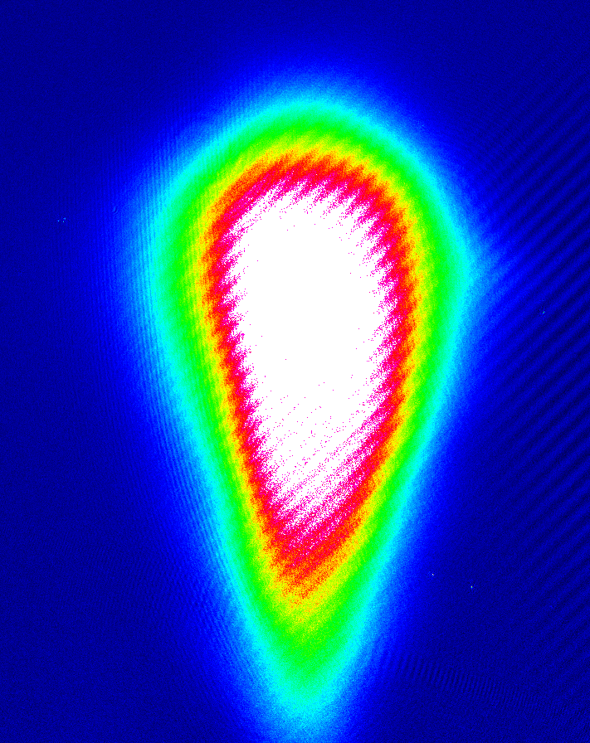
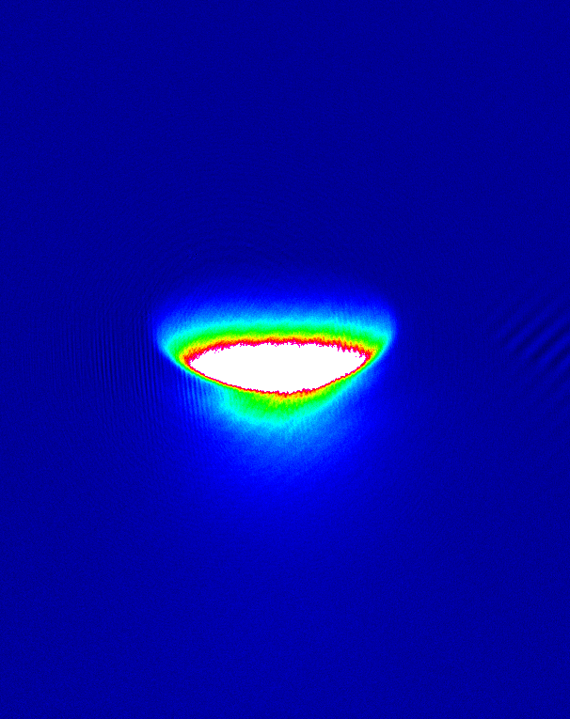
Narrow line cooling
¹P₁
2 mm
³P_{J}
blue MOT
461 nm
30 MHz
2
1
J
0
hot blue MOT
T ~ 1 mK
PSD ~ 10⁻¹⁰
cold red MOT
T ~ 1 µK
PSD ~ 10⁻³
red MOT
689 nm
7.4 kHz
¹S₀

Slide 16
Cooling in trap
T ~ 1 µK
PSD ~ 0.1
dipole trap
cooling laser

Slide 17
BEC using dimple trick
T ~ 1 µK
PSD ~ 0.1
dipole trap
potential

Slide 18

BEC using dimple trick
T ~ 1 µK
PSD > 2.6
dipole trap
potential
BEC

Slide 19
Transparency beam
¹P₁
³S₁
dipole trap
cooling laser
2
1
J
³P_{J}
0
red MOT
689 nm
7.4 kHz
¹S₀
³P₁
cooling laser
¹S₀
potential

Slide 20
Transparency beam
¹P₁
³S₁
dipole trap
transparency beam
transparency
cooling laser
2
1
J
³P_{J}
0
red MOT
689 nm
7.4 kHz
¹S₀
³P₁
cooling laser
¹S₀
potential

Slide 21
Transparency beam
¹P₁
³S₁
dipole trap
transparency beam
transparency
cooling laser
2
1
J
³P_{J}
0
red MOT
689 nm
7.4 kHz
¹S₀
³P₁
cooling laser
¹S₀
potential
transparency beam

Slide 22
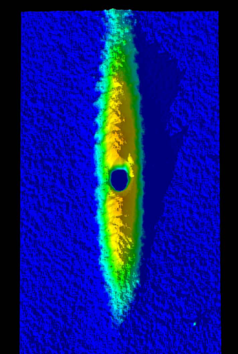
Transparency beam
¹P₁
³S₁
dipole trap
transparency beam
transparency
cooling laser
2
1
J
³P_{J}
0
red MOT
689 nm
7.4 kHz
¹S₀
³P₁
cooling laser
¹S₀
potential
BEC!
without
with
transparency beam
transparency beam

Slide 23
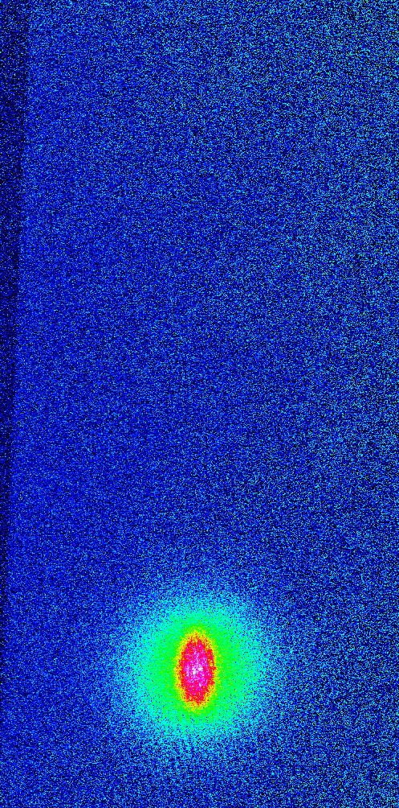
Transparency beam
¹P₁
³S₁
dipole trap
transparency beam
transparency
cooling laser
Laser cooling to BEC
2
1
J
Phys. Rev. Lett. 110, 263003 (2013)
³P_{J}
0
red MOT
689 nm
7.4 kHz
¹S₀
³P₁
cooling laser
laser cooling alone removes entropy
quantum gas in laser cooled cloud
¹S₀
potential
BEC!
without
with
transparency beam
transparency beam

Slide 24
Continuous atom laser
New requirements
1) Pumping: replenish atoms
BEC
2) Outcoupling
Challenge: BEC not protected from blue photons

Slide 25
Blue stray light protection
Sr beam
source
blue Zeeman slower
blue 2D MOT
red 2D molasses
atomic beam
continuous-wave BEC
red MOT
dipole guide
future atom laser
red Zeeman slower
Challenge: BEC not protected from blue photons

Slide 26
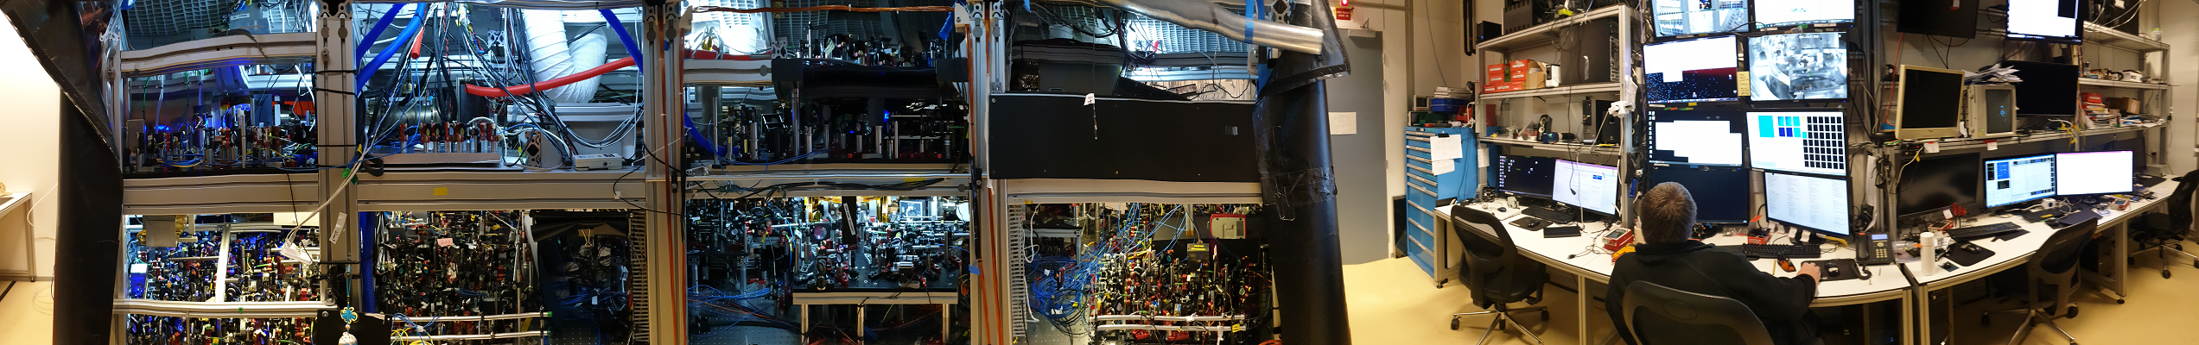
Design and construction
Sr beam
source
Zeeman slower
blue 2D MOT
red 2D molasses
atomic beam
continuous-wave BEC
red MOT
dipole guide
future atom laser
red Zeeman slower

Slide 27
Design and construction
Sr beam
source
Zeeman slower
blue 2D MOT
red 2D molasses
atomic beam
continuous-wave BEC
red MOT
dipole guide
future atom laser
red Zeeman slower

Slide 28

Dipole guide to darkness
bright region (laser cooling beams)
dark region
35 mm
slower beam
dipole guide
push beam
5mm
Guided beam
Atom flux = 9 x 10⁶ ⁸⁴Sr/s
Speed = 9 cm/s
T_{transport, vert} = 0.9 μK
1mm

Slide 29
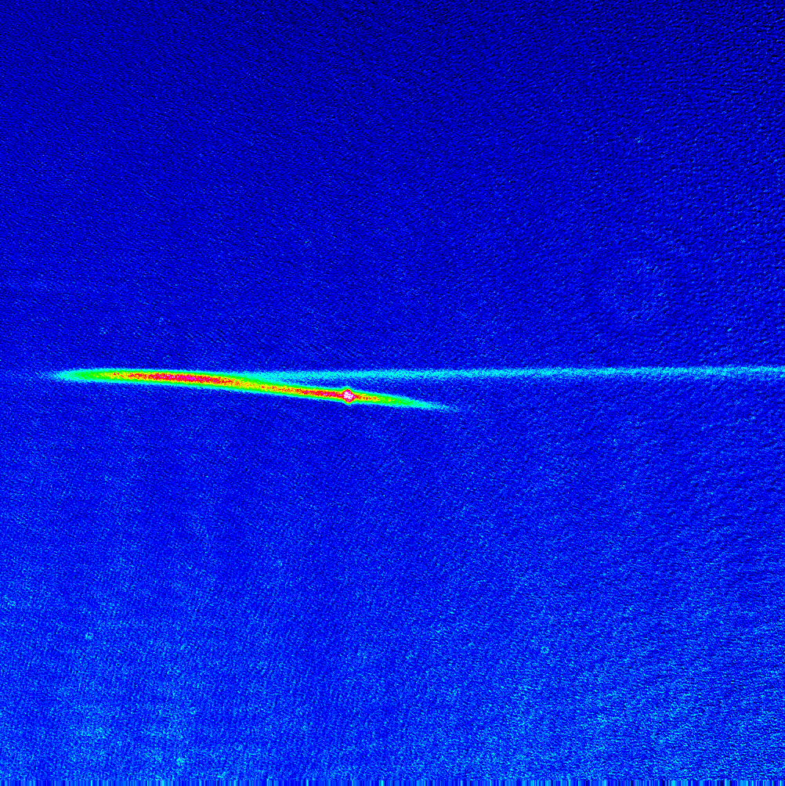
Dipole guide to darkness
bright region (laser cooling beams)
dark region
35 mm
slower beam
dipole guide
push beam
Top View
5mm
1mm
Side View
Guided beam
Atom flux = 9 x 10⁶ ⁸⁴Sr/s
Speed = 9 cm/s
T_{transport, vert} = 0.9 μK
1mm

Slide 30
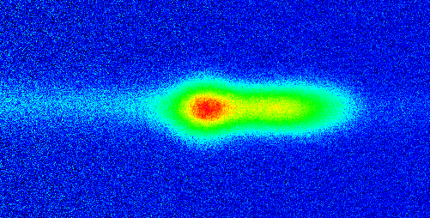
BEC in steady-state?
In situ
1mm
18 ms expansion
1mm

Slide 31
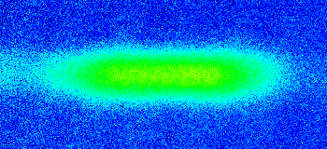
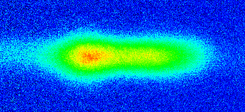
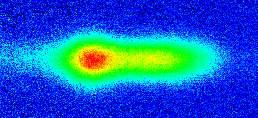
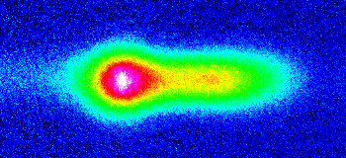
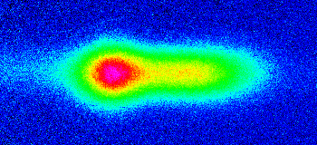
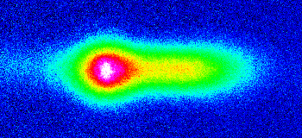
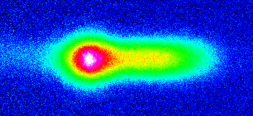
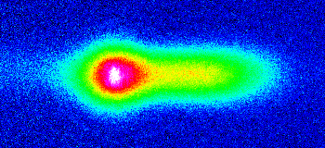
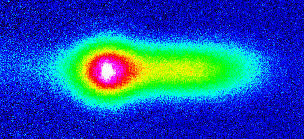
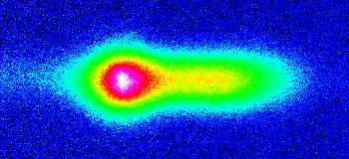
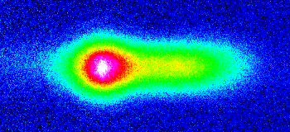
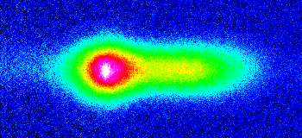
BEC in steady-state?
30
t (s)
0
2
5
15
60
1.1s
1.5s
2.0s
9.5s
2.4s
3.4s
5s
13.5s
15s
30s
60s
45s

Slide 32
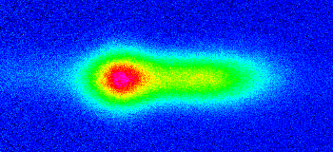
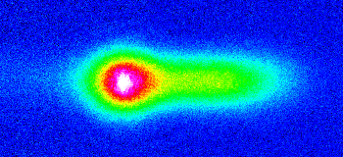
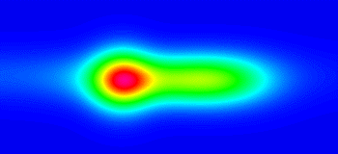
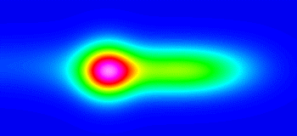


BEC detection
Image after 18ms expansion
2.4s
15s
Thermal fit
3 Gaussians + Gauss tube
Fit residue
BEC!
1mm

Slide 33
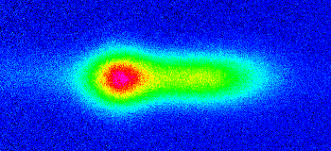
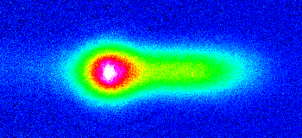




BEC detection
Image after 18ms expansion
2.4s
15s
Thermal + BEC fit
3 Gaussians + Gauss tube + TF
Fit residue
1mm
Notes:
Benjamin’s fit 2020 02 28
191226 S1018 P0121 2.4s
191226 S1018 P0084 15s

Slide 34
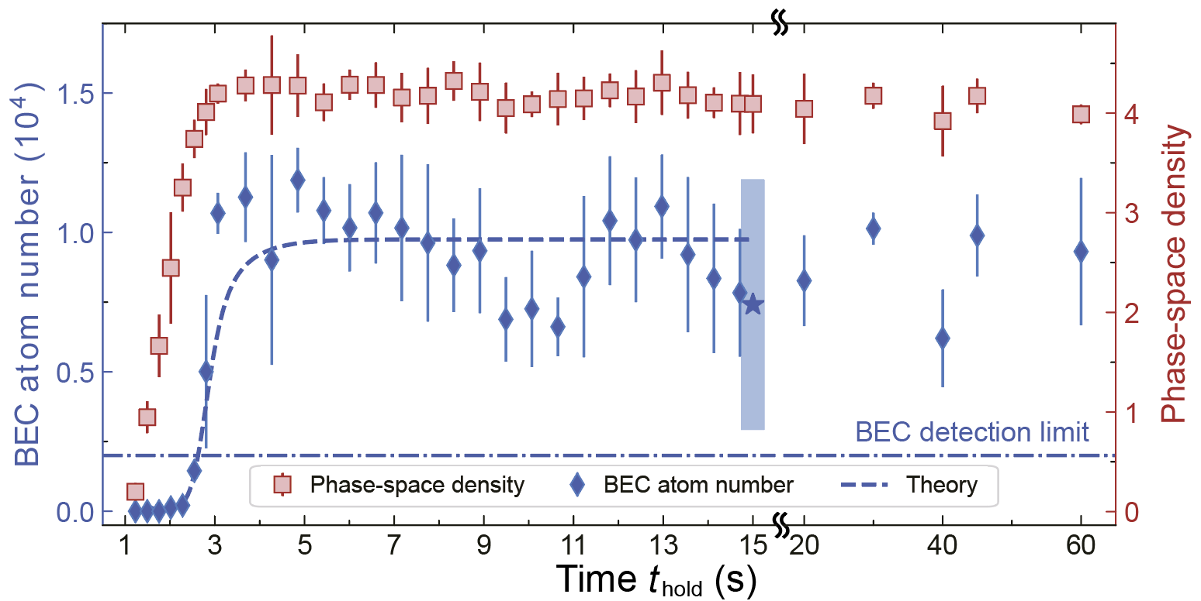
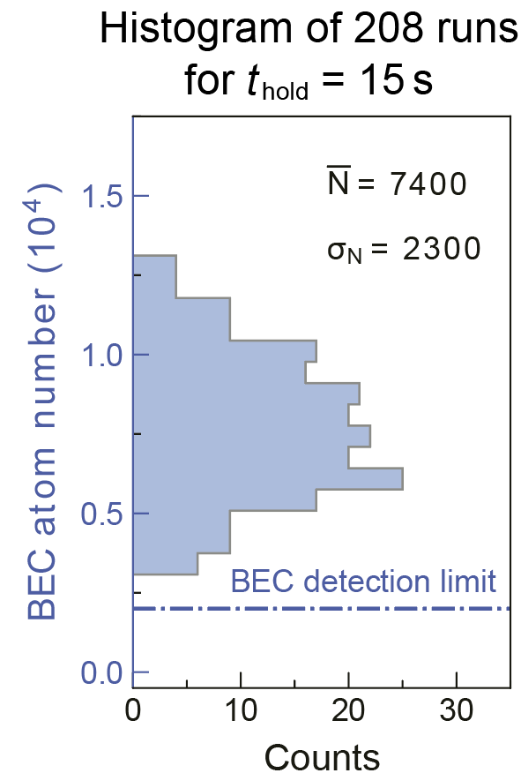
BEC formation
arXiv:2012.07605

Slide 35
Characterization of steady-state
arXiv:2012.07605
BEC: N = 7.4(2.4) x 10³ ⁸⁴Sr atoms
Replenishment rate 10⁵ atoms/s
Dimple: N = 6.9(4) x 10⁵ T_{vertical} = 1.08(3) μK
Reservoir: N = 7.3(1.8) x 10⁵
Loading rate 1.1(4) x 10⁶ atoms/s
Model assuming thermalized gas does not describe data.
Model assuming enhanced occupation of higher trap states fits data.
Signature of driven, dissipative nature of system?
Future direction: driven-dissipative many-body physics
BEC purity oscillations
new critical exponents
unusual quantum phases, especially in lower dimensions
Phys. Rev. Lett. 88, 170403 (2002), Phys. Rev. A 93, 033617 (2016)
Phys. Rev. Lett. 110, 195301 (2013)
Phys. Rev. Lett. 118, 085301 (2017)
Driven-dissipative BECs created with
exciton-polaritons Rev. Mod. Phys. 82, 1489 (2010)
magnons Nat. Phys. 4, 198 (2008)
photons Nature 468, 545 (2010)

Slide 36
Creating an atom laser: method 1
Atom cavity (trap)
Pumping
replenish atoms
Gain
(e.g. Bose-enhanced scattering)
BEC
Add outcoupling mechanism
e.g. Raman transfer to untrapped, metastable state
N.P. Robins et al., Atom lasers: Production, properties and prospects for precision inertial measurement, Phys. Rep. 529, 265 (2013)

Slide 37
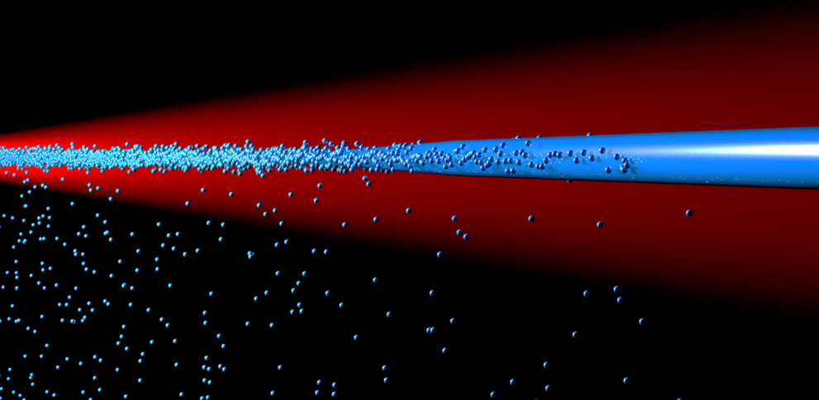
Creating an atom laser: method 2
Add evaporative cooling, e.g.
bright region (laser cooling beams)
dark region
slowdown
transfer dipole guide
10 cm/s
<1 cm/s
push beam
evaporation dipole guide
Slowdown using e.g. Sisyphus optical lattice decelerator, Phys. Rev. A 100, 023401 (2019)
Enhance Sr laser cooling scheme, e.g. Katori group, Phys. Rev. A 103, 023331 (2021)

Slide 38
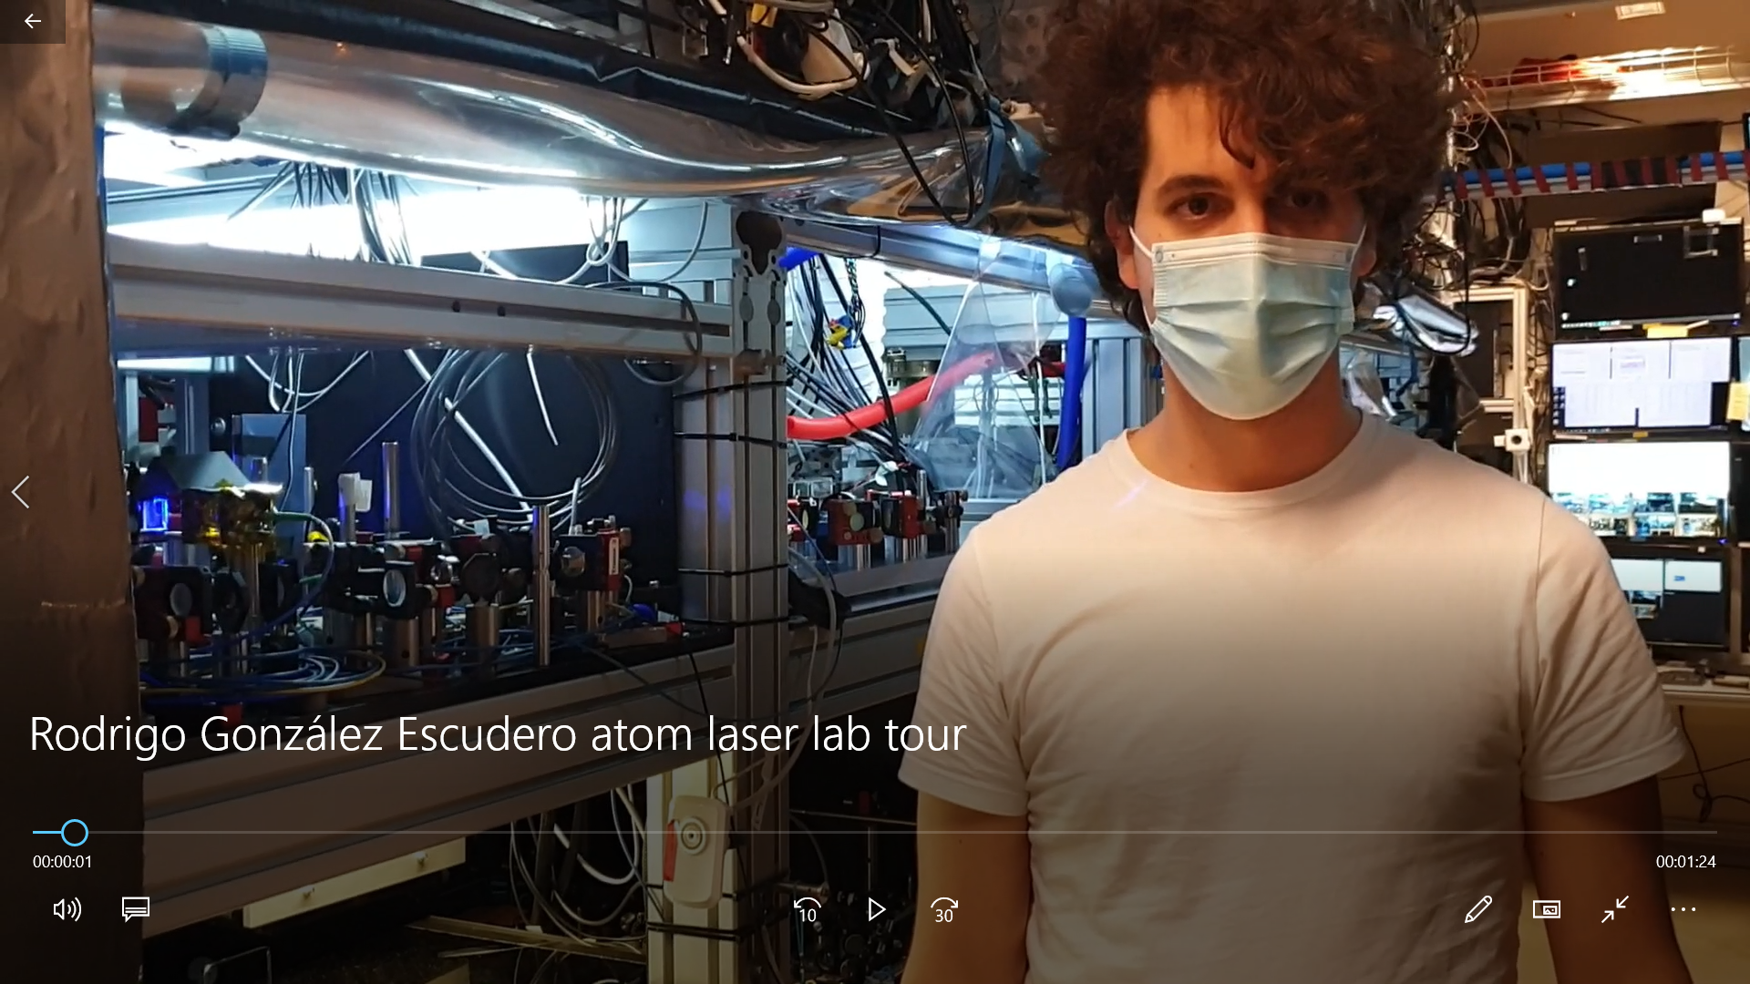

Slide 39
Outline
µK Sr beam in the dark
Continuous-wave BEC
100µm
Superradiant clock
Continuous-wave atom laser
frequency & time
acceleration & rotation

Slide 40
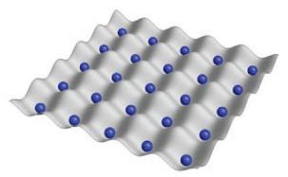

Optical lattice clock scheme
Frequency reference
ultracold Sr atoms in lattice
Blue laser cooling
Red laser cooling
Interrogate
Blue laser cooling
Red laser cooling
Interrogate
…
time
Flywheel
Clockwork
optical resonator
optical frequency comb
keeps frequency while ultracold atoms are prepared
translates optical frequency into radiowave frequency
laser

Slide 41
Challenges
Frequency reference
ultracold Sr atoms in lattice
Blue laser cooling
Red laser cooling
Interrogate
Blue laser cooling
Red laser cooling
Interrogate
…
only intermittently available
time
Flywheel
Clockwork
optical resonator
optical frequency comb
keeps frequency while ultracold atoms are prepared
translates optical frequency into radiowave frequency
not easy to operate on moving vehicle
laser

Slide 42
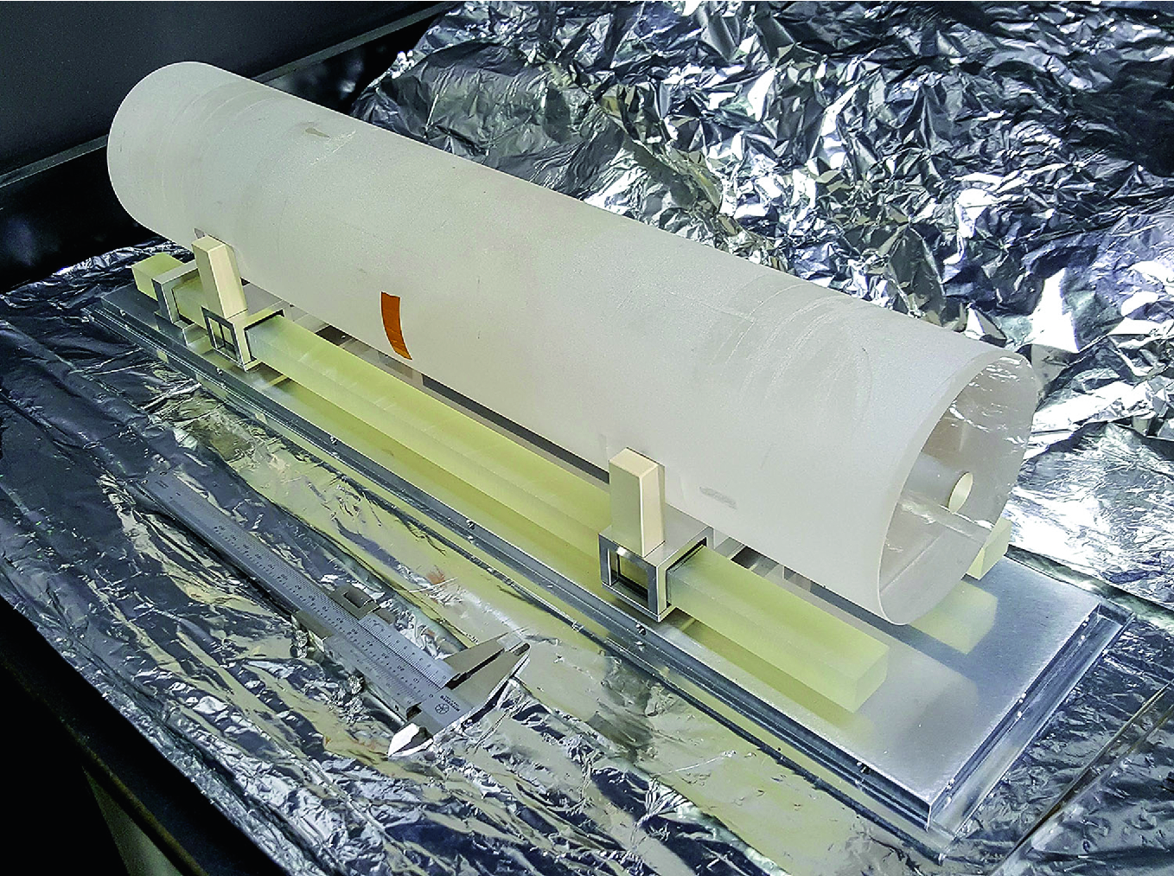






Ultrastable resonators
Ultralow expansion glass cavity
Silicon monocrystal cavity
Crystalline mirror coatings
PTB
QUEST
JILA
Limit: thermal length changes of spacer
Limit: thermal noise in coatings
PTB, 8 × 10⁻¹⁷ fractional laser frequency instability with a long room-temperature cavity, Optics Lett. 40, 2112 (2015)
PTB, JILA: 1.5 μm Lasers with Sub-10 mHz Linewidth, Phys. Rev. Lett. 118, 263202 (2017)
Aspelmeyer group, Tenfold reduction of Brownian noise in high-reflectivity optical coatings, Nature photonic 7, 644 (2013)

Slide 43

Superradiant clock
Passive clock
Active, superradiant clock
ultracold Sr atoms in lattice
laser
Continuous ultracold strontium beam in
Clock laser beam out

Slide 44



Comparison to standard laser
Standard laser: frequency stability from length of cavity
good-cavity regime:
cavity mode
gain profile
Superradiant clock laser: frequency stability from ensemble spin of atoms
bad-cavity regime:
cavity mode
gain profile

Slide 45
Active optical clock
Goal: photons from mHz linewidth transition
Challenges:
minutes of excited state lifetime
emission into 4π
Solution: enhance emission into single mode by superradiance
Jingbiao Chen, arXiv:physics/0512096 (2005), Chinese Science Bulletin 54, 348 (2009)
D. Meiser, J. Ye, D. R. Carlson, M. J. Holland, PRL 102, 163601 (2009)

Slide 46





Phased array of N emitters
Closer spaced than wavelength
Random phase
Closer spaced than wavelength
Same phase
Spaced wavelength/2 along axis
Alternating phase
Electric field
Electric field (arb. units.)
Random interference
Constructive interference
Constructive interference along axis
E-field ~ Sqrt(N)
E-field ~ N
Power ~ N
Power ~ N²
Power along axis ~ N²

Slide 47








How is superradiance established?
Bloch vector
E-field

Slide 48


Superradiant lasers
James Thompson group, JILA: pulsed superradiance Rb Raman transition, Nature, 484, 78 (2012)
pulsed superradiance on Sr mHz transition, Science Advances, 2, e1601231 (2016)
N = 2 x 10⁵
1.5 x 10⁵
1.25 x 10⁵
10⁵
Andreas Hemmerich group (Hamburg): pulsed Ca superradiance on 379-Hz transition, PRL 123, 103601 (2019)
Jan Thomsen group (Copenhagen): pulsed Sr superradiance on kHz transition, PR A 101, 013819 (2020)
Related: Jingbiao Chen group (Beijing): continuous Cs bad-cavity laser on 1.8-MHz transition, IEEE Trans. Ultrason. Ferroelectrics. Freq. Contr. 65, 1958 (2018)

Slide 49

How can superradiance be maintained?

Slide 50



Hydrogen maser
Continuous superradiant microwave emission, used as frequency reference

Slide 51



Continuous superradiant Sr lasers
Version 1
Version 2
Version 3
kHz transition
mHz transition
mHz transition
hot atomic beam
continuous ultracold beam
from periodically refilled reservoir
continuous ultracold beam

Slide 52

V1: kHz-transition superradiant Sr laser
Jingbiao Chen
Active Optical Clock
arXiv:physics/0512096 (2005), Chinese Science Bulletin 54, 348 (2009)
H. Liu, S. B. Jäger, X. Yu, S. Touzard, A. Shankar, M. J. Holland, and T. L. Nicholson
Rugged mHz-Linewidth Superradiant Laser Driven by a Hot Atomic Beam
PRL 125, 253602 (2020)
Key requirements
sufficient atom flux
~ 10¹² atoms/s through cavity mode
~ 10⁵ atoms in cavity mode
low velocity along cavity
~ 0.4 m/s
Expected performance V1.1
Linewidth ~ 100 Hz
Power ~ 100 nW

Slide 53
V1: kHz-transition superradiant Sr laser
Jingbiao Chen
Active Optical Clock
arXiv:physics/0512096 (2005), Chinese Science Bulletin 54, 348 (2009)
H. Liu, S. B. Jäger, X. Yu, S. Touzard, A. Shankar, M. J. Holland, and T. L. Nicholson
Rugged mHz-Linewidth Superradiant Laser Driven by a Hot Atomic Beam
PRL 125, 253602 (2020)

Slide 54

V1: kHz-transition superradiant Sr laser
Jingbiao Chen
Active Optical Clock
arXiv:physics/0512096 (2005), Chinese Science Bulletin 54, 348 (2009)
H. Liu, S. B. Jäger, X. Yu, S. Touzard, A. Shankar, M. J. Holland, and T. L. Nicholson
Rugged mHz-Linewidth Superradiant Laser Driven by a Hot Atomic Beam
PRL 125, 253602 (2020)

Slide 55
V1: kHz-transition superradiant Sr laser
Cavity for superradiant lasing
Optical pumping to upper lasing state
Velocity selective optical pumping to metastable state
Transversal cooling
Beam oven

Slide 56

V1: kHz-transition superradiant Sr laser

Slide 57
Continuous superradiant Sr lasers
Version 1
Version 2
Version 3
kHz transition
mHz transition
mHz transition
hot atomic beam
continuous ultracold beam
from periodically refilled reservoir
continuous ultracold beam

Slide 58
Continuous mHz-transition superradiant lasers
D. Meiser, J. Ye, D. R. Carlson, M. J. Holland,
Prospects for a Millihertz-Linewidth Laser
PRL 102, 163601 (2009)
Key requirements
confine atoms along cavity
μK temperature beam
protect superradiant ensemble from laser cooling photons
sufficient atom flux
~ 10⁵ ⁸⁷Sr or 10⁶ ⁸⁸Sr atoms
in cavity mode
Expected performance V2.1
Linewidth ~ mHz
Continuous ultracold strontium beam in
Clock laser beam out
Power ~ 1 pW

Slide 59


Continuous mHz-transition superradiant lasers
continuous ultracold beam from periodically refilled reservoir
continuous ultracold beam
V2
V3
V3
Oven section
UHV section
3D MOT
Transport lattices
Reservoir
Oven + 2D blue MOT
2D blue MOT
2D red molasses
Ring cavity
Transport lattice
Red Zeeman slower
Red 2D or 3D MOT
Ring cavity
Vibration isolation stack
Vibration isolation stack

Slide 60


Slide 61
Summary
µK Sr beam in the dark
Continuous-wave BEC
100µm
Superradiant clock
Continuous-wave atom laser
frequency & time
acceleration & rotation

Slide 62


iqClock – integrated quantum clock
Main objectives
bring optical clocks from lab to society
kick-start European optical clock industry
Industry partners
Collaboration
Murray Holland group
Travis Nicholson group
Te2v | Teledyne e2v
Toptica | Toptica
NKT | NKT Photonics
Acktar | Acktar
Chronos | Chronos
BT | British Telecom
Academic partners
UvA | University of Amsterdam
UoB | The University of Birmingham
UMK | Nicolaus Copernicus University
UCPH | Copenhagen University
TUW | Technical University of Vienna
UIBK | University of Innsbruck

Slide 63









Our projects
Quantum sensing
Quantum simulation
Continuous atom laser
RbSr molecules
Superradiant clock
Rydberg coupled Sr atoms
Quantum Flagship
M. J. Holland &
T. L. Nicholson
groups

Slide 64



















The team
atomlaser
iqClock
RbSr
Sr tweezer
Zeyuan Zhang
(master)
Thies
Plaßmann
(master)
Camila Beli Silva
(PhD)
PhD and research assistant positions available
Premjith Thekkeppat
(PhD)
Francesca Famà
(PhD)
Klaasjan van Druten (Co-PI)
Benjamin
Pasquiou
(Co-PI)
Jens Samland
(former master)
Sergey
Pyatchenkov
(former PhD)
Chun-Chia
Chen
(former PD)
Rodrigo
González Escudero
(PhD)
Shayne
Bennetts
(postdoc)
Florian
Schreck
(PI)
Stefan Alaric Schäffer
(postdoc)
Vincent
Barbé
(former PhD)
Sheng Zhou
(PhD)
Lukas
Reichsöllner
(former postdoc)
Robert Spreeuw
(Co-PI)
Jiri
Minar
(postdoc,
theory)
Alex
Urech
(PhD)
Thies Plassman
(master)
Mikkel Tang
(guest PhD)
Programme QuSim 2.0
Zwaartekracht QCS
Matteusz Borkowski
(postdoc)
Veni & Vici
NWA Startimpuls II QuNav
Ivo Knottnerus
(PhD)
Quantum Flagship

